Slide 1

Oncor Electric Capstone Program
Team:
Iris Zhou
Sahar Khan
Gangadhar Sallagundla Chowdary
Jiaowei Wang

Slide 2


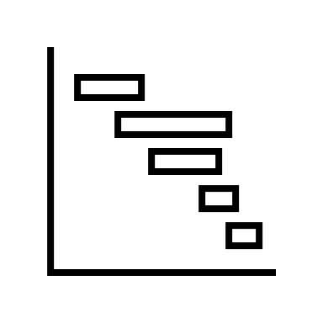




AGENDA
Executive summary
Cluster Analysis
Machine Learning
Recommendations
Data Preparation
Statistic Modeling

Slide 3
Executive summary
Increase recruitment of participants for energy efficiency programs
K-Means clustering to identify target audience segments
Multinomial Regression Model to determine predictive factors for program participation
Top 3 Programs analysis
Increase program enrollment and customer satisfaction
Positive and Negative Key Features to determine probability of enrollment and its Impact

Slide 4
Data Preparation Process
Data Cleaning
Deleted unrelated columns
Feature Engineering
Mean Impute on Numeric Null
Exploratory Data Analysis
Program and Channel Preference
Standalone column for No selection of program
Unified Column values
Demographics
Housing
Social Media
Socioeconomics
Add Region Column
One-Hot Encoding on Categorical Variables
Normalize Numeric columns

Slide 5
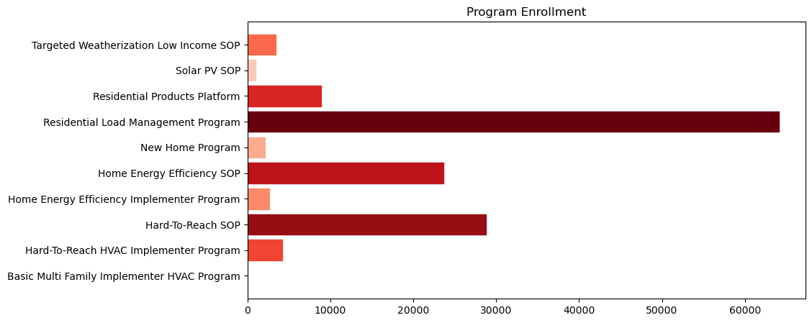


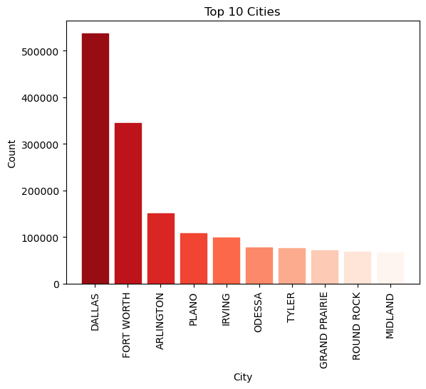
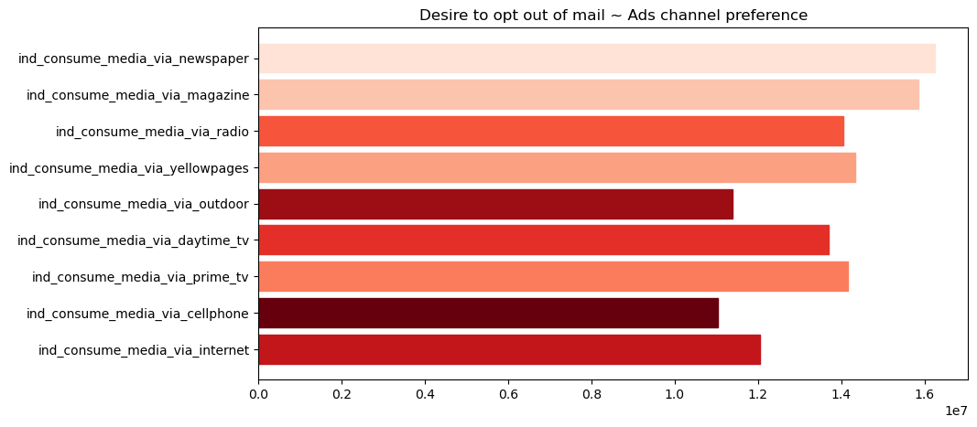
What Does the Data Reveal?
Voice - Most Preferred Channel
Mail Preference for Purchase

Slide 6
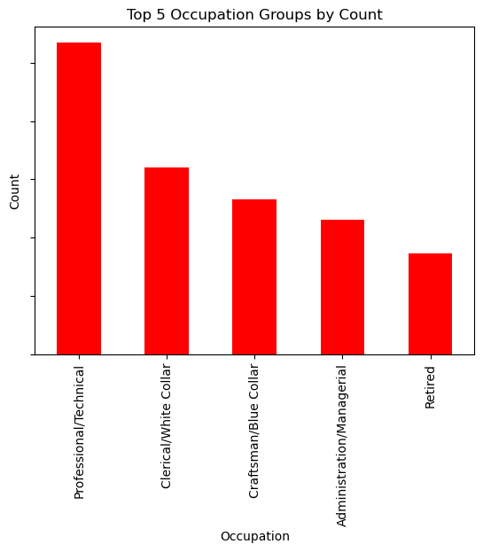
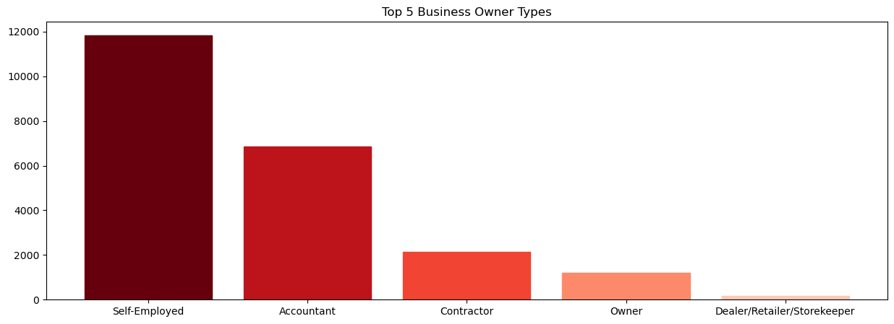
What Does the Data Reveal?
Professional/ Technical has the highest enrollment amount among all the occupations
Self-employed has the highest enrollment amount among all the business owner types,

Slide 7



What Does the Data Reveal?
Social Media
Photo Poster
Video Poster
Test Poster
55-60 Age Group
Majority Male Customers
Race - White
Top 3 Home properties: Single Family, Mobile Home, and Condo
Customers reside in their homes for either over 14 years or less than a year
Home Lot Square Footage: 5,000 - 10,000 sq ft and 10,001 - 15,000 sq ft

Slide 8


Clustering Analysis --- Why K-Means Clustering
Business Purpose
Technical Purpose
Understanding the target audience and their preference​
Identifying the marketing goal to decide on customer segmentation​
Using the powerful tool to improve effectiveness and scalability
Clustering
Analysis
Simple to understand and implementing ​
Highly efficient algorithm that can handle large datasets with ease​
Can be applied to a wide range of datasets and data types(numerical, categorical, and binary data, using tableau to interpret each cluster)

Slide 9
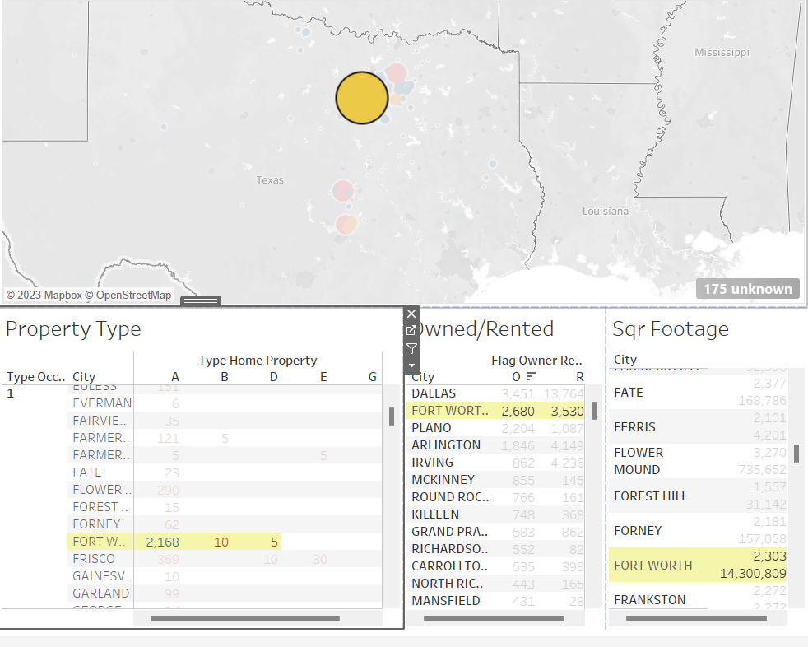
Clustering Analysis --- Dashboard
General Review of the traits by city
Property Type
Square Footage
Ownership Statue

Slide 10
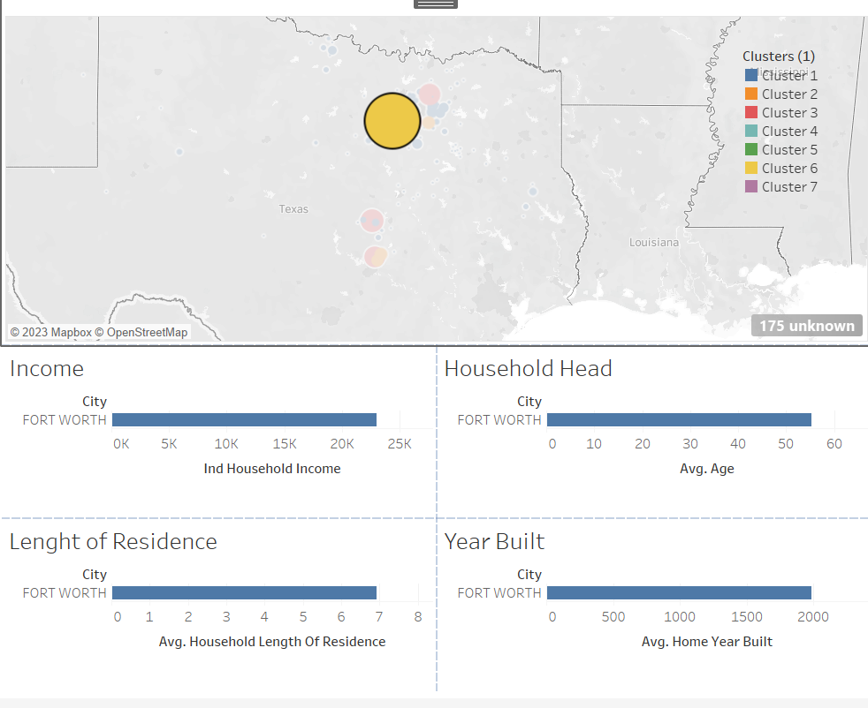
Clustering Analysis --- Dashboard
Specific to Market
Income
Household Head​​ Age
Property Built Year
Residence
Length​​

Slide 11
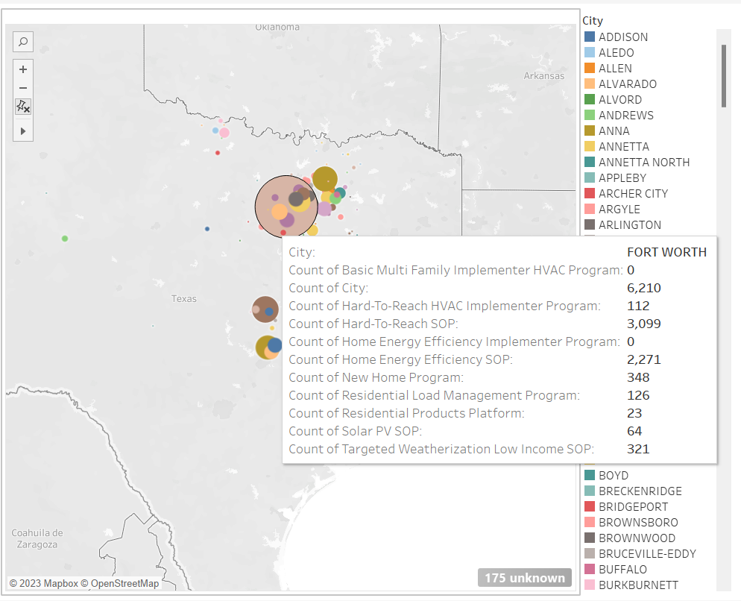
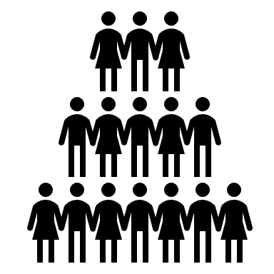




Clustering Analysis --- Dashboard
For User
Enables users and powers them with information about different program types
Give users access to data about the specific number of clients enrolled.
Presents the information by various locations and cities to users for reference

Slide 12
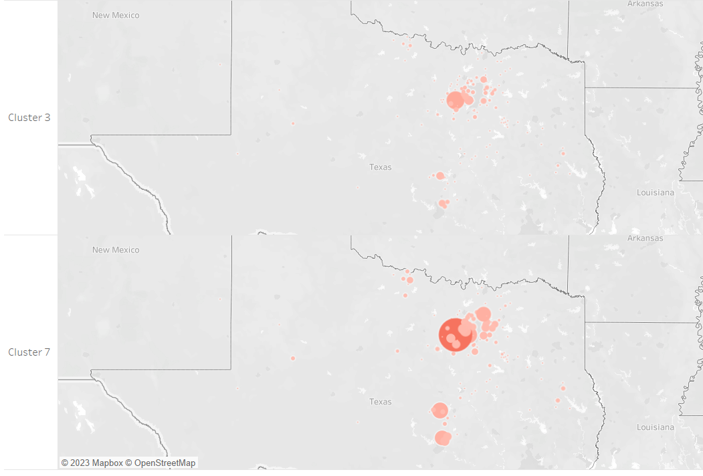
Stage 3 : DASHBOARD INSIGHTS
We went with 7 clusters over 3 clusters to get more specific and on point results. there are distinct subgroups or patterns in the data that suggest the need for more clusters.

Slide 13

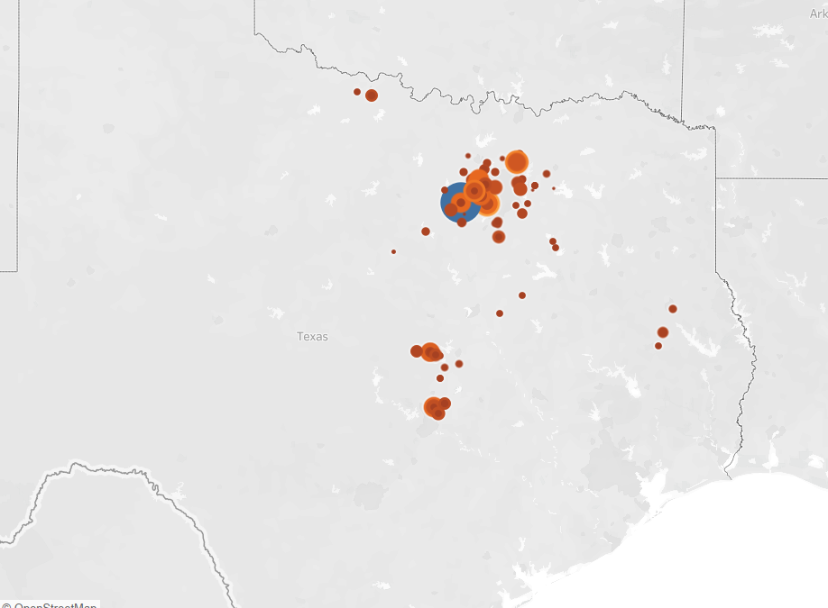



Residential Load Management Program
Popular
Cost savings: By incentivizing users to reduce their energy consumption during peak periods, which can help lower their monthly electricity bills.
Environmental benefits: By reducing energy consumption during peak time to help reduce the strain on the power grid, which saves new power plants and decreases greenhouse gas emissions.
Rebates and incentives: Users are eligible for rebates and incentives, which can further increase the cost savings and make it more attractive to participate.

Slide 14
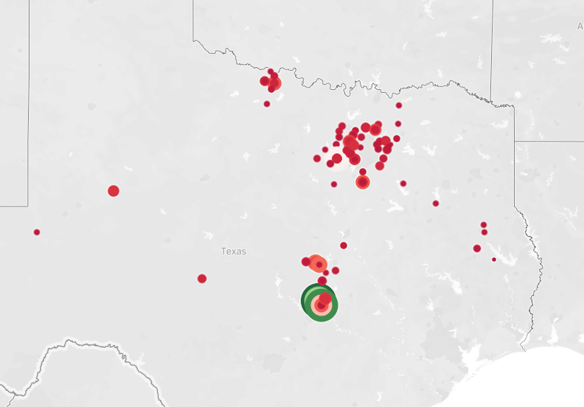

Popular
Generally opted by individuals with lower income levels
Solar PV SOP
Reduced energy bills: allowing low-income customers to install solar panels on their homes, which can help reduce their monthly energy bills. This can be particularly attractive to people with limited income or have troubles to pay their bills.
Financial assistance: Offering financial assistance to cover the cost of installing solar panels, allowing low-income customers who may not have the resources to pay for it on their own.

Slide 15

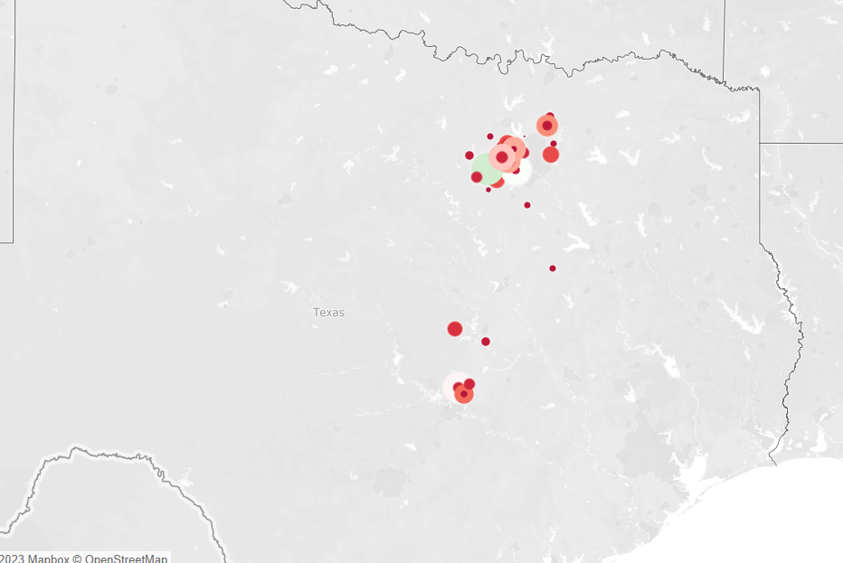






Residential Products Platform
most diverse
Variety of Products: The platform offers a wide range of energy-efficient products and services that customers can choose from, including smart thermostats, LED lighting, HVAC upgrades, insulation, and more.
Inclusive for all Income Groups: The program is designed to be inclusive and accessible to all income groups, with incentives and rebates available to both residential and commercial customers.
Multiple Vendors: The program works with multiple vendors, which means customers have access to a diverse range of products and services from a variety of manufacturers and suppliers.
Residential Products Platform is the most diverse program popular across many segments, with client income's varying the most compared to the other programs.

Slide 16
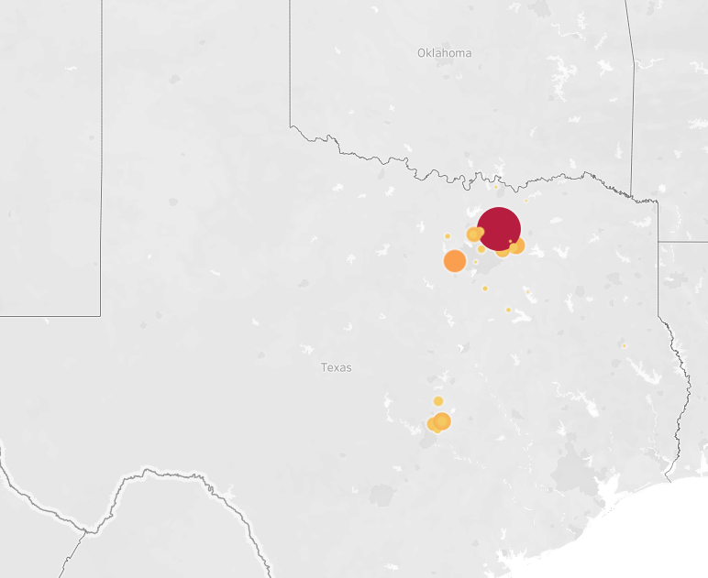
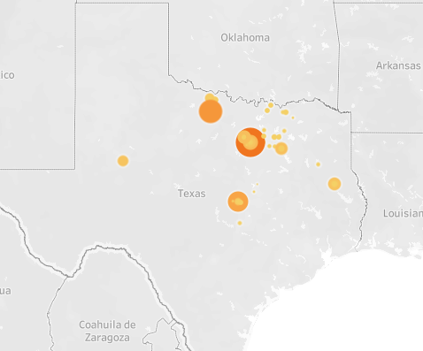
Distributions of Other Programs
New Home Program
Targeted Weatherization Low Income SOP

Slide 17
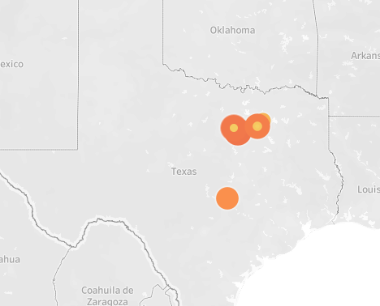
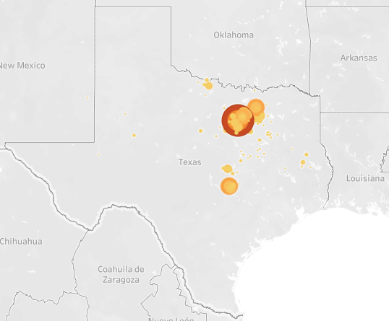
Distributions of Other Programs
Home Energy Efficiency Implementer Program
Home Energy Efficiency SOP

Slide 18
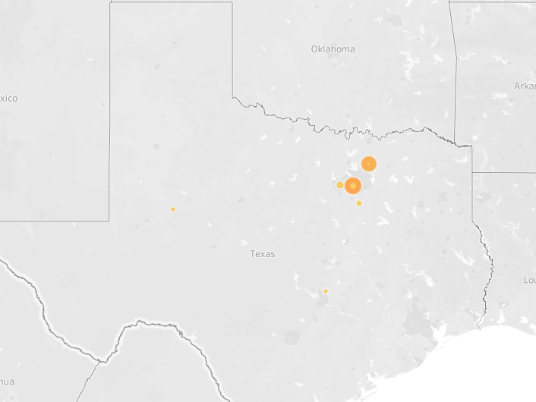
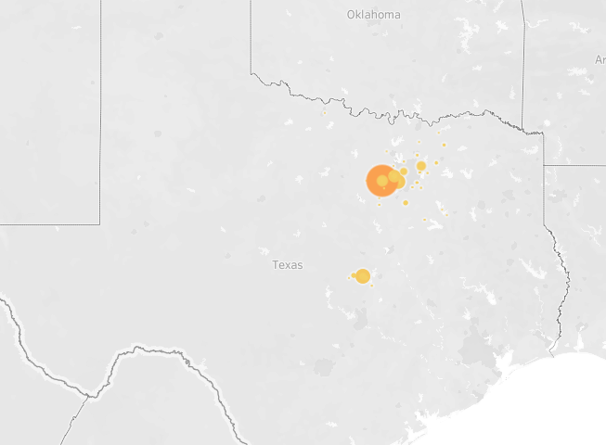
Distributions of Other Programs
Hard-to-Reach HVAC Implementer Program
Hard-to-Reach SOP

Slide 19
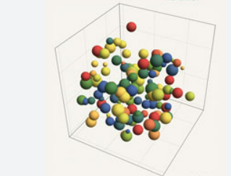
Statistical Modeling --- Multinomial Logistical Regression
Predicting Categorical Outcomes
Easy to Interpret
Handles Multiple Predictors
Requires No Assumptions About Data Distribution
Provides a Good Fit
Overall, multinomial logistic regression is a powerful and flexible statistical model that can be used to predict outcomes in a wide range of situations.
Its ability to handle multiple predictors, provide clear and interpretable results, and require no assumptions about data distribution make it a strong choice for the project.

Slide 20
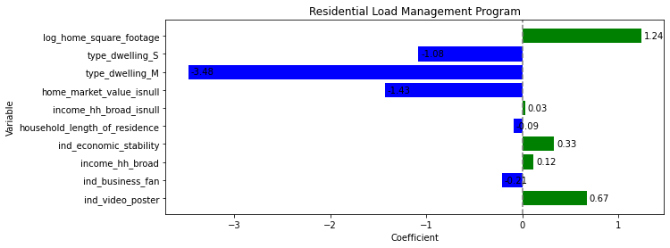
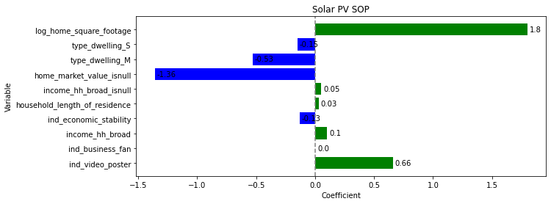
Statistical Modeling --- Key Features
After transformation, setting unbiased, reduction, and we select the feature based on importance weights. Finally, we find the key features which are significant in each program.
Similarities
Positive Correlation
Home Square Footage, Video-poster, income-broad
Negative Correlation:
home-market-value-is-null, Dwelling type-s,
Dwelling type-M, economy-stability
Differences
Solar PV SOP:
Home square footage has a more highly positive impact.
Residential Load Management Program:
Multi Family dwelling type has a more negative impact.

Slide 21
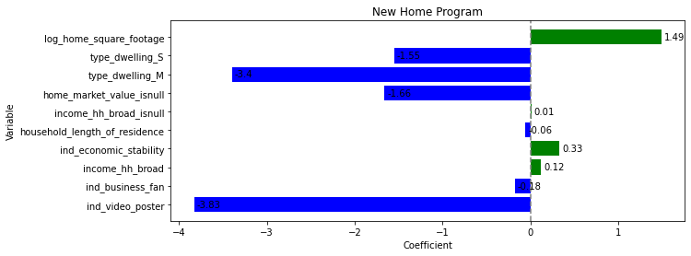
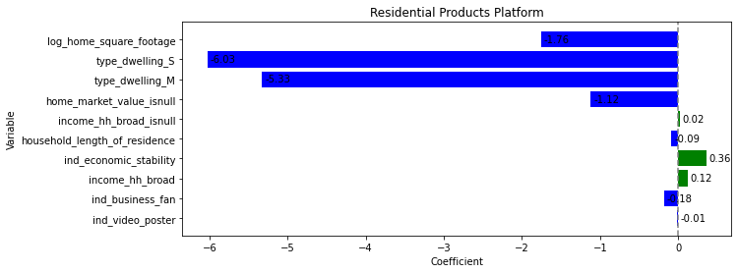
Statistical Modeling --- Key Features
Similarities
Positive Correlation:
Economy-stability
Income-broad
Negative Correlation:
Dwelling type-S, Dwelling type-M, Home Market Value is null, video poster,
Differences
New Home Program:
Home Square Footage has a highly positive impact
Residential Products Platform:
Video Poster has a highly negative impact

Slide 22
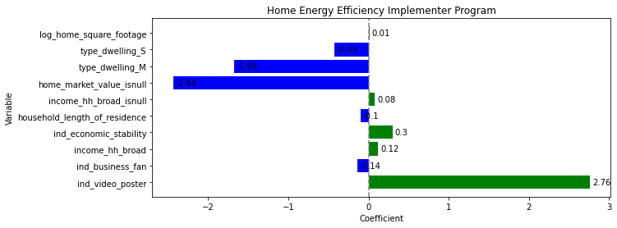
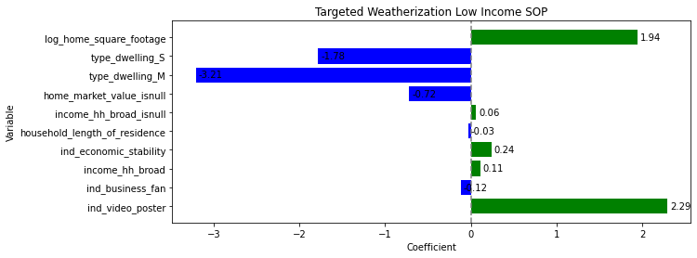
Statistical Modeling --- Key Features
Similarities
Positive Correlation:
Home Square Footage, Video poster, economy-stability, Income-broad
Negative Correlation:
home-market-value-is-null, Dwelling type-s,Dwelling type-M
Differences
Targeted Weatherization Low Income SOP:
Home Square has a highly impact.

Slide 23
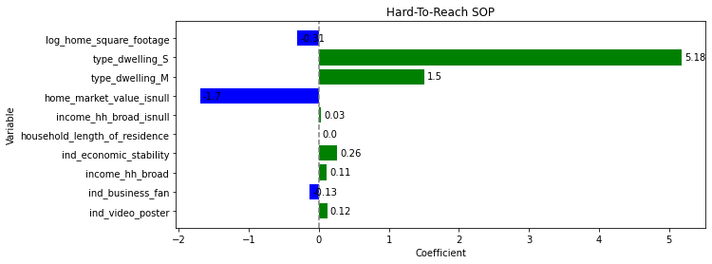
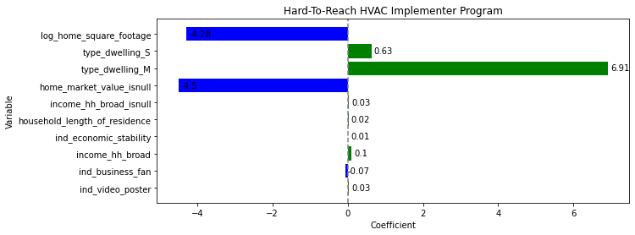
Statistical Modeling --- Key Features
Similarities
Positive Correlation:
Dwelling type-S, Dwelling type-S, Economy-stability
Negative Correlation:
Home Square Footage, home-market-value-is-null
Differences
Hard-To-Reach HVAC Implementer Program:
More sensitive with home square footage
Dwelling type are opposite

Slide 24
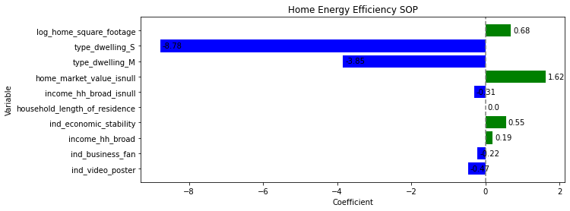
Statistical Modeling --- Key Features
Similarities
Positive Correlation:
Home Square Footage, home-market is null, economy-stability, Income-broad
Negative Correlation:
Dwelling type-S, Dwelling type-M, video poster, business fan, income-hh-broad is null
It’s sensitive with dwelling type-s

Slide 25
Machine Learning
In many cases, machine learning models can be seen as an extension or generalization of statistical models, and may incorporate statistical techniques such as regression or hypothesis testing. However, the emphasis in machine learning is often on predictive accuracy rather than interpretability, and the models are often designed to be more flexible and adaptable to different types of data.
Statistical Modeling
Purpose: Help to interpret feature
Find key feature for each program with statistical significance
Machine Learning
Purpose: Predictive accuracy
Find ideal model with high accuracy to be used in production

Slide 26
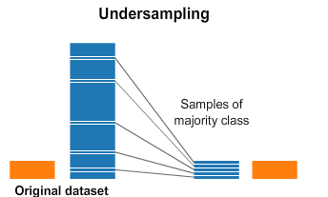
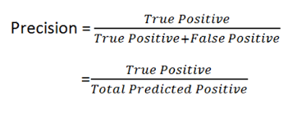
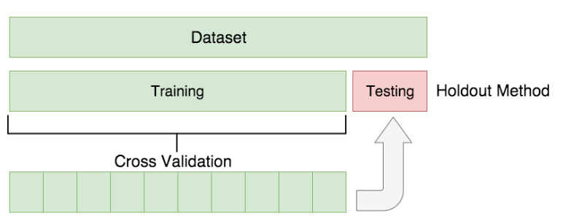
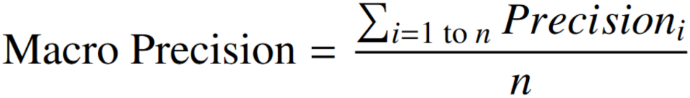
Machine Learning --- Process Overview
01
02
03
04
Preprocessing on Engineered Features
Shuffle Data Handle
Unbalanced data
5-Fold Cross Validation
Evaluation Metric for Test Set:
Accuracy
Train/Test Split
Evaluation Metrics for Cross Validation: Macro Precision
Train/ Test Ratio:
80%/ 20%

Slide 27
Machine Learning --- Modeling Results
5-Fold Cross Validation AUC:
Train Performance | Logistic Regression | Random Forests | XGBoost
Macro Precision | 57.7% | 60.8% | 61.8%
Test Performance | XGBoost
Macro Precision | 61.1%

Slide 28



Recommendation---Business Strategy
Focusing on expanding the residential load management program and promoting it in multi-family buildings to attract more enrollments.
Leveraging the voice channel to offer quick and easy transactions that cater to customer preferences.
Providing personalized services to customers who prefer to make purchases via mail and investing in market research to stay up-to-date on customer needs and preferences.
Reducing its mail solicitation efforts and advocating more on social media platforms to gain higher visibility.
Tailoring its marketing campaigns to target the 55-64 age group, males, and the most common business types and occupations identified in the analysis

Slide 29


Recommendation---Business Strategy
Target Segments
Main Regions – Fort Worth, Especially Western Region
Other Regions – Round Rock, Pflugerville , McKinney and Balch Springs
These are the traits for highest income people in that region.
Majority of the customers Own a house , a few are rented , with a mixture of Single and Martial status
Princeton, Prosper, Alvarado – We can promote the New Home Program here as these areas are developing fast and more new buildings are emerging.
Grand Prairie, University Park, Highland Park – The home sizes are the highest in these cities, we might have to push the solar program here to reduce the overall carbon footprint and promote sustainability
Notes:
Main Regions – FortWort, Especially Western Region
Other Regions – Round Rock, Pflugerville , Mckinney and Balch Springs
These are the traits for highest income people in that region.
Majority of the customers Own a house , a few are rented , with a mixture of Single and Marial status

Slide 30

Recommendation---Each Program
Solar PV SOP
Target customer: Those who are in middle or older age live in single-family houses with large footage, for a longer time, have good economic status, and less like video posts.
Recommendation: Focus on the southwest, people who have a stable income live in large single-family for a long time. Utilizing voice channels or email to touch them.
Residential Load Management Program
Target customer: Those who live in single-family houses with large footage, in a short time, have good economic status, and less like video posts.
Recommendation: Focus on the western​, who just move i​n and care about Smart Thermostats, has a stable income. Utilizing voice channels or email to touch them.
New Home Program
Target customer: Those who live in new single-family houses with large footage, in a short time, have good economic status, and most like video posts.
Recommendation: Focus on metro east, requires a strategic approach that takes into account their preferences and behaviors. By utilizing video marketing, social media advertising, special promotions, and partnerships with real estate agents, businesses can effectively engage with this customer group and promote their products or services.
Notes:
Main Regions – FortWort, Especially Western Region
Other Regions – Round Rock, Pflugerville , Mckinney and Balch Springs
These are the traits for highest income people in that region.
Majority of the customers Own a house , a few are rented , with a mixture of Single and Marial status

Slide 31
Recommendation---Each Program
Residential Products Platform
Target customer: Those who live in the apartment with less footage, in a short time, have good economic status, and like video posts.
Recommendation: Focus on western. It requires a targeted approach that takes into account their specific preferences and behaviors. By utilizing social media advertising, influencer marketing, email marketing, virtual events, and personalized recommendations, businesses can effectively engage with this customer group and promote their products or services.
Home Energy Efficient Implementer Program
Target customer: Those who live in single-family houses, in a short time, have good economic status, and less like video posts.
Recommendation: Focus on metro east. It requires a strategic approach that takes into account their preferences and behaviors. By utilizing video marketing, social media advertising, special promotions, and partnerships with real estate agents, businesses can effectively engage with this customer group and promote their products or services.
Targeted Weatherization Low Income SOP
Target customer: Those who live in single-family houses with large footage, in a short time, have good economic status, and less like video posts.
Recommendation: Focus on Western, it requires a targeted approach that takes into account their specific preferences and behaviors. By utilizing print advertising, content marketing, events and sponsorships, referral programs, and personalized outreach, businesses can effectively engage with this customer group and promote their products or services.
Notes:
Main Regions – FortWort, Especially Western Region
Other Regions – Round Rock, Pflugerville , Mckinney and Balch Springs
These are the traits for highest income people in that region.
Majority of the customers Own a house , a few are rented , with a mixture of Single and Marial status

Slide 32
Recommendation --- Each Program
Home Energy Efficiency SOP
Target customer: Those who live in apartment with large footage, have very good economic status, and like video posts.
Recommendation: Focus on southwest, requires a personalized approach that takes into account their specific preferences and behaviors. By utilizing video marketing, social media advertising, influencer partnerships, and referral programs, businesses can effectively engage with this customer group and promote their products or services.
Hard-To-Reach HVAC Implementer Program
Target customer: Those who live in the apartment with less footage,
Hard-To-Reach SOP
Target customer: Those who live in single-family houses with less footage less like video posts.
Recommendation: marketing to customers who live in single-family houses with less footage requires a personalized approach that takes into account their specific preferences and behaviors. By utilizing email marketing, direct mail campaigns, in-person events, social media advertising, and referral programs, businesses can effectively engage with this customer group and promote their products or services.
Recommendation: marketing to customers who live in small apartments requires a strategic approach that takes into account their space constraints and needs. By showcasing space-saving products, utilizing online advertising and social media marketing, and providing personalized marketing campaigns and showroom events, businesses can effectively engage with this target customer group and promote their products or services.
Notes:
Main Regions – FortWort, Especially Western Region
Other Regions – Round Rock, Pflugerville , Mckinney and Balch Springs
These are the traits for highest income people in that region.
Majority of the customers Own a house , a few are rented , with a mixture of Single and Marial status

Slide 33
Key Findings for Marketing Strategies
Subjects | Finding | Suggestion
Types of Dwelling | Participants living in family dwellings are more likely to participate in the energy programs | People who live in family dwellings or smaller homes have higher potential to be future customers
Household Income | Participants with higher household income levels are more likely to participate in the energy programs | Putting more marketing efforts towards higher-income households, emphasizing the financial benefits of the programs
Interest in Video Posters | Participants who have indicated an interest in video posters (e.g., promotional videos) are more likely to participate in the energy programs | Video posters could be an effective way to engage more potential customers
Home Market Value | Participants with null values for home market value are less likely to participate in the energy programs | Advocating energy programs can provide benefits for home value
Home Square Footage | participants with larger homes tend to have lower participation rates | Marketing efforts can be tailored to highlight the benefits of the energy programs for participants living in smaller homes and Vice versa

Slide 34
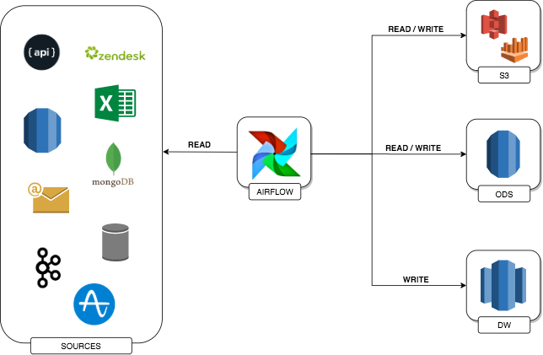
Recommendation --- Operationalization of the Model
Export trained XGBoost model in a format that can be used by Apache Airflow.
Define Airflow DAG that will run the XGBoost model on a regular schedule, including tasks for loading and preprocessing data from data sources and running the XGBoost prediction.
Store the prediction results into Operational Databases so that the web developers can pick up the results and serve them to each customer on the front end as program recommendations
Notes:
What is the principle of XGBoost algorithm?
XGBoost is an optimized distributed gradient boosting library designed to be highly efficient, flexible and portable. It implements Machine Learning algorithms under the Gradient Boosting framework. It provides a parallel tree boosting to solve many data science problems in a fast and accurate way.

Slide 35


